Slide 1
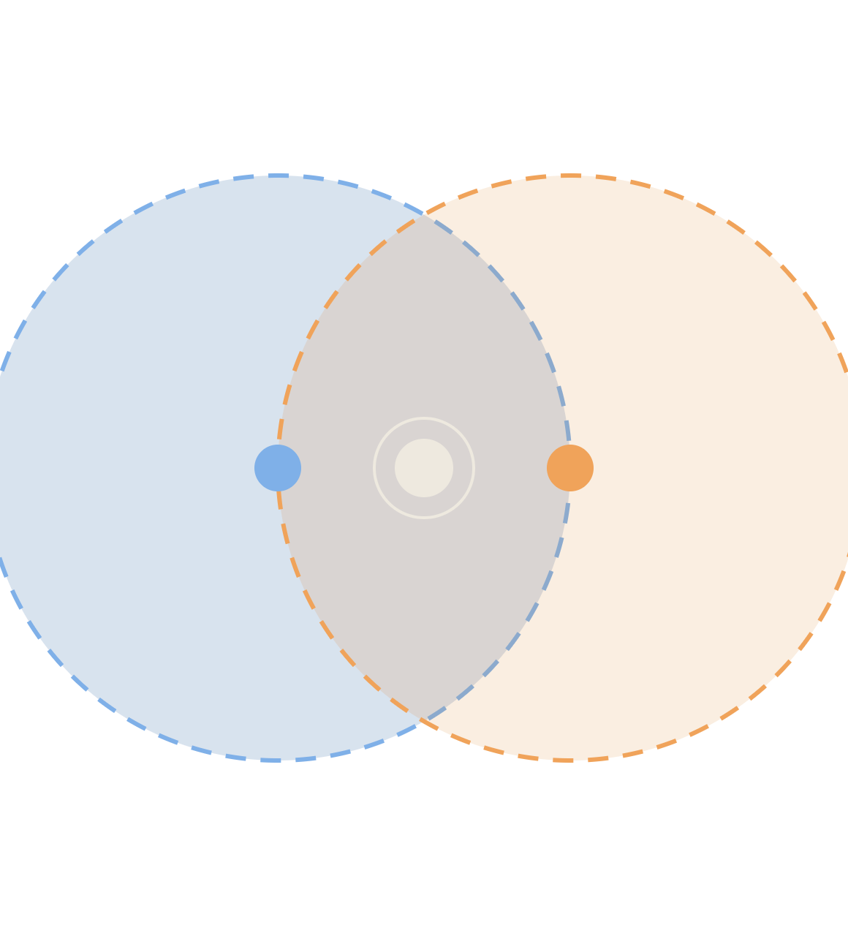
Hidden & Exposed Terminals in the Wild
WSN · MAC-LAYER PATHOLOGY
Three real deployments, dissected: body area networks, smart-meter meshes and drone-served farms
Wireless Sensor Networks · evidence from public papers, standards documents and patents
Notes:
Goal of the session: students already know the A–B–C picture. Today we show where it actually bites, with published evidence, and why the textbook fix (RTS/CTS) mostly does not apply to sensor networks. Each case is dissected with the same anatomy: deployment, propagation cause, hidden terminal, exposed terminal, evidence, treatment.

Slide 2
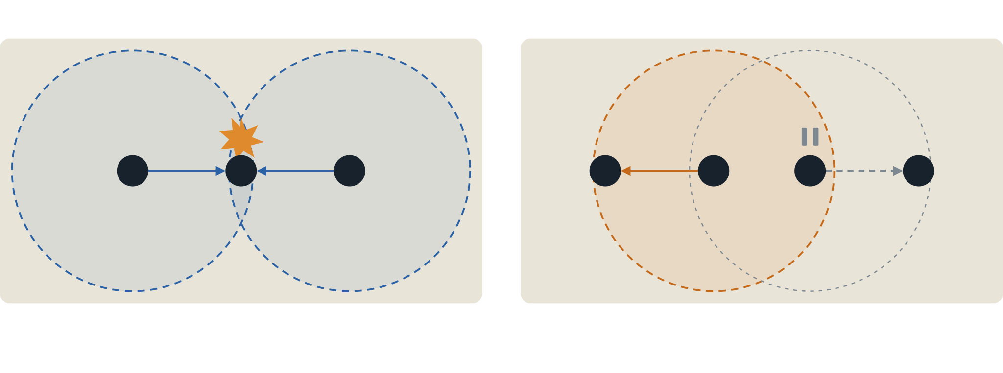
Two ways carrier sense misleads a node
Hidden terminal: senders can't hear each other
Exposed terminal: a sender defers for nothing
A
B
C
A
B
C
D
A and C both sense an idle channel and send. Their frames collide at B, and neither sender knows why.
C hears B and pauses. Yet B→A and C→D could both succeed: A is out of C's reach, D out of B's.
Circles = sensing range · blue = hidden-terminal story · orange = exposed-terminal story
Notes:
Root cause in both: the sender decides based on what IT hears, but success depends on what the RECEIVER hears. Hidden terminal costs collisions (energy, retransmissions). Exposed terminal costs throughput and latency (lost spatial reuse). Keep the colour code: blue = hidden, orange = exposed.

Slide 3
The textbook fix rarely ships in sensor radios
01 · STANDARD
02 · OVERHEAD
Not in IEEE 802.15.4
Tiny frames can't pay for it
No 802.15.4 release defines an RTS/CTS handshake, so ZigBee, Wi-SUN and 6LoWPAN stacks inherit none [1].
Added experimentally, RTS/CTS beat basic access on bandwidth efficiency only once about 5 frames were concatenated [1].
03 · TRAFFIC
04 · PHYSICS
Broadcast has nobody to CTS
Interference outreaches decoding
Floods, beacons, routing updates and time sync go to everyone, so no single receiver can reserve the channel.
A node too far to decode the CTS can still be close enough to corrupt the data frame it was meant to protect.
[1] Barroca et al., IET Wireless Sensor Systems, 2020 · cards 03–04: general MAC reasoning
Notes:
Students' default answer is RTS/CTS. Four reasons it does not rescue WSNs. Cards 1 and 2 are evidenced by Barroca et al. 2020: they note no 802.15.4 release proposes RTS/CTS, and in their analysis RTS/CTS only beats basic access on bandwidth efficiency beyond roughly five aggregated frames. Cards 3 and 4 are standard MAC reasoning. Note RTS/CTS also does nothing for exposed terminals; it actually silences more nodes.

Slide 4
HOW MUCH DOES EXPOSED-TERMINAL DEFERRAL WASTE?
40–75%
of the time, two sender–receiver pairs on 802.15.4 radios could transmit at once without loss, even when both transmitters sat inside sensing range of both receivers.
Every one of those deferrals is airtime that carrier sense threw away.
[2] Son, Krishnamachari, Heidemann, USC/ISI TR-639, 2007 · MicaZ / CC2420 testbed and simulation
Notes:
Son et al. measured concurrent transmissions on MicaZ/CC2420 (the classic 802.15.4 radio). They report concurrency succeeds often, 40 to 75 percent of the time depending mainly on distance and location, even when both transmitters are within sensing range of both receivers. Their observed SINR threshold on MicaZ was about 2 dB. Caveat for students: this is a technical report, not a peer-reviewed paper, and it measures concurrency opportunity rather than "exposed terminal rate" directly. That opportunity is exactly what conservative carrier sense forgoes.

Slide 5
One anatomy for every case
01
02
03
Body
Physiology
Pathology I
The deployment: where nodes live, the topology, the traffic pattern.
The propagation cause: what blocks, absorbs or extends the radio here.
The hidden terminal: which pair can't hear each other, and why.
04
05
06
Pathology II
Evidence
Treatment
The exposed terminal: who defers needlessly, and what it costs.
Published measurements, standards text or patents that show it is real.
What real deployments do about it, and what that fix costs.
MEASURED
backed by published data
MECHANISM
reasoned from the physics; test it yourself
Notes:
The metaphor: we dissect each deployment like a specimen. Every claim on the case slides carries a tag. MEASURED means a cited paper, standard or patent states it. MECHANISM means it follows from the physics but I could not find a paper measuring that exact effect, which makes it a good lab or project question.

Slide 6
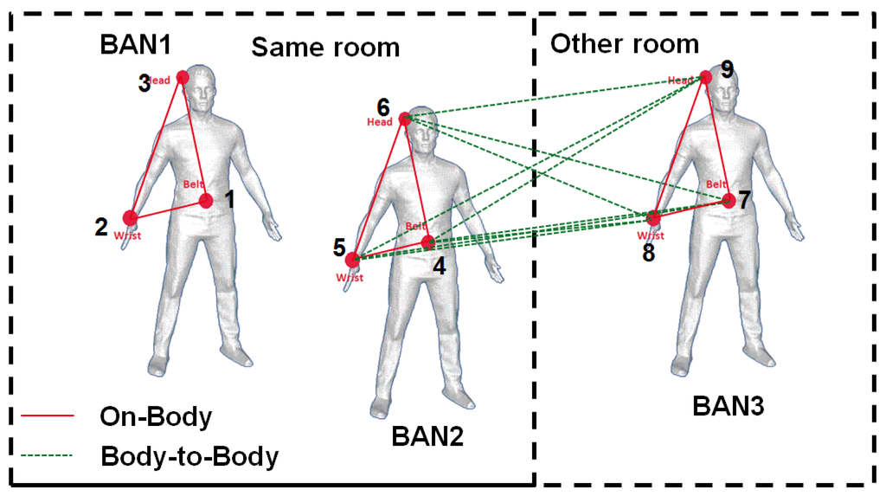
The multi-patient ward
CASE 1 · BODY AREA NETWORK
Each patient wears ECG, SpO₂ and motion sensors that report to a hub on the hip. Several patients share one room, and often one channel.
Layer | This deployment
Standard | IEEE 802.15.6, or 802.15.4
Topology | A star per body, many bodies per room
Traffic | Periodic vitals plus time-bounded alarms
Photo slot · on-body node placement, e.g. from Alam et al., Sensors 2016 (open access, CC BY)
Notes:
Set the scene. A BAN is a star around one person; a ward is many stars overlapping in one room. Two separate pathologies: inside one body (hidden terminals from body shadowing) and between bodies (exposed and hidden terminals from co-located BANs). Drop a photo into the frame from the editor if you have one.

Slide 7
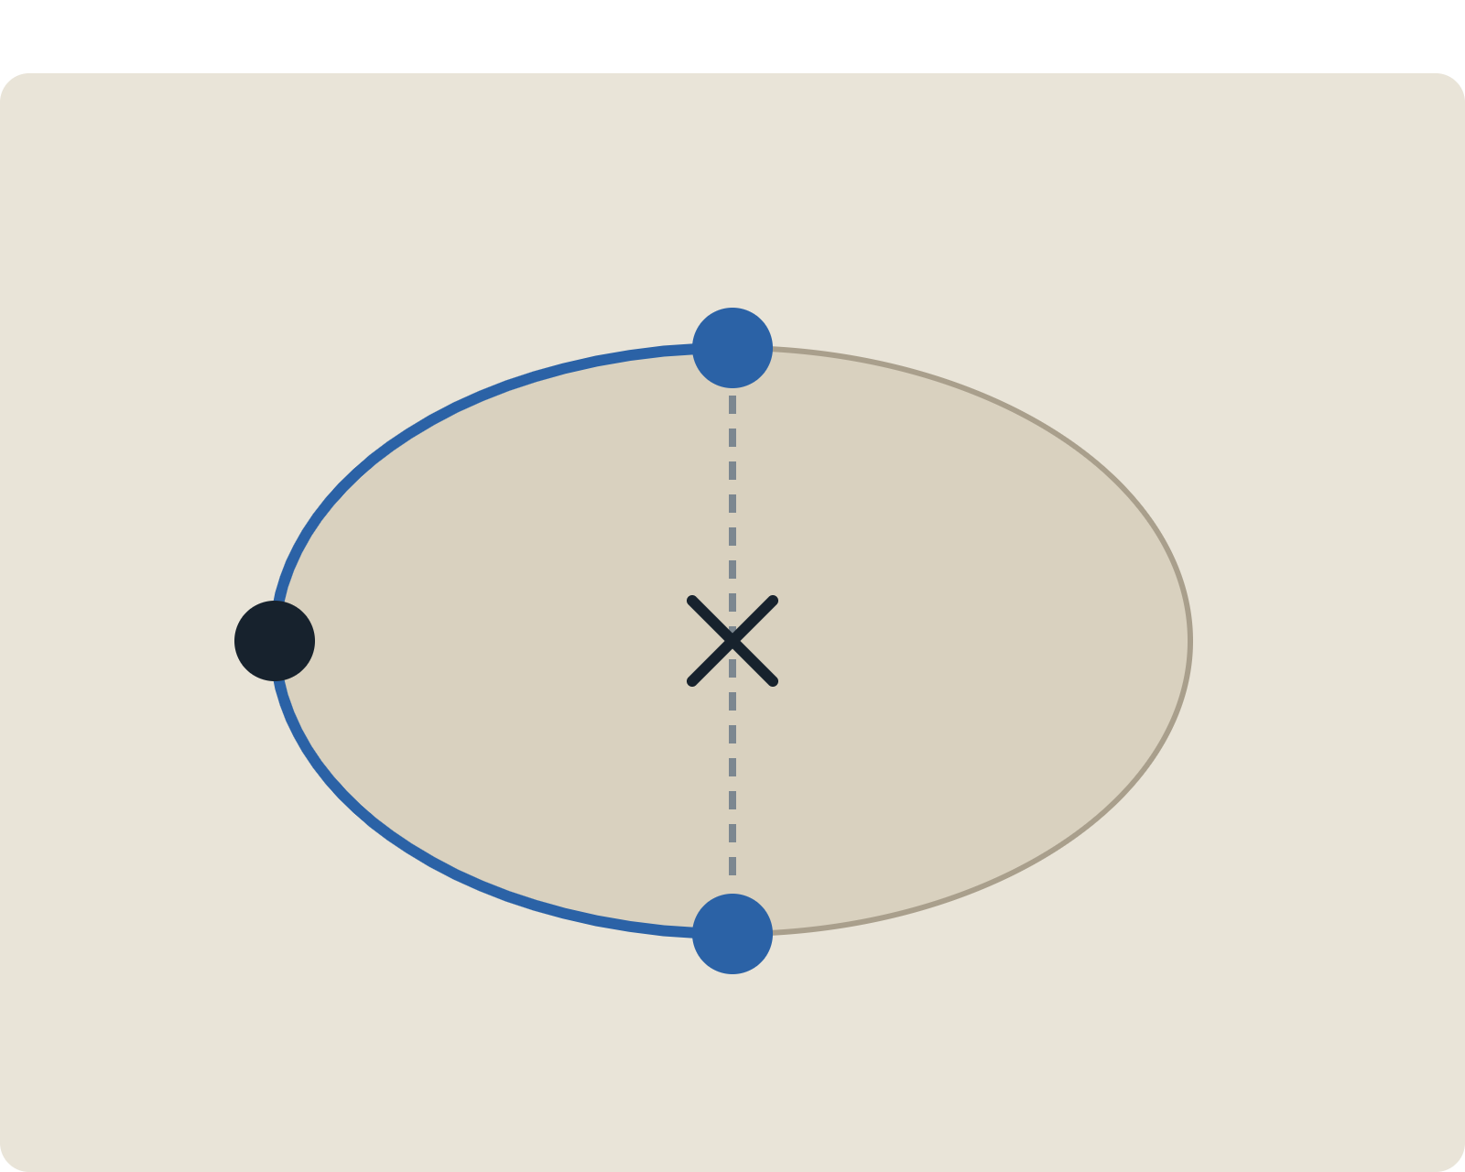
Inside one body, the torso is the wall
TOP-DOWN SLICE · FRONT AT BOTTOM
PHYSIOLOGY · MEASURED
The body absorbs and shadows 2.4 GHz. The 802.15.6 channel model splits body-surface links into line-of-sight and non-line-of-sight cases for this reason [3].
Back sensor
PATHOLOGY I · MECHANISM
Back and chest each reach the hub around the side, never each other. Both sense idle, both send, and the hub sees a collision.
No path through
TIME-VARYING · MEASURED
Hub (hip)
Shadowing tracks posture and rotation [4], so hidden pairs appear and vanish as a patient turns in bed.
Chest ECG
[3] IEEE P802.15-08-0780, Channel Model for BAN, 2009 · [4] Alam et al., Sensors 16(4):561, 2016
Notes:
Physiology: at 2.4 GHz the torso is a lossy obstacle. The IEEE 802.15.6 channel model document distinguishes body-surface-to-body-surface LOS and NLOS scenarios (CM3). Alam et al. 2016 built measurement-based traces that include body orientation and rotation, so shadowing is time-varying. Pathology: a back sensor and a chest sensor are classic hidden terminals relative to a hip hub. This specific pairing is tagged MECHANISM: I did not find a paper measuring hidden-pair rates inside one BAN, which makes it a nice lab exercise with two motes and a volunteer.

Slide 8
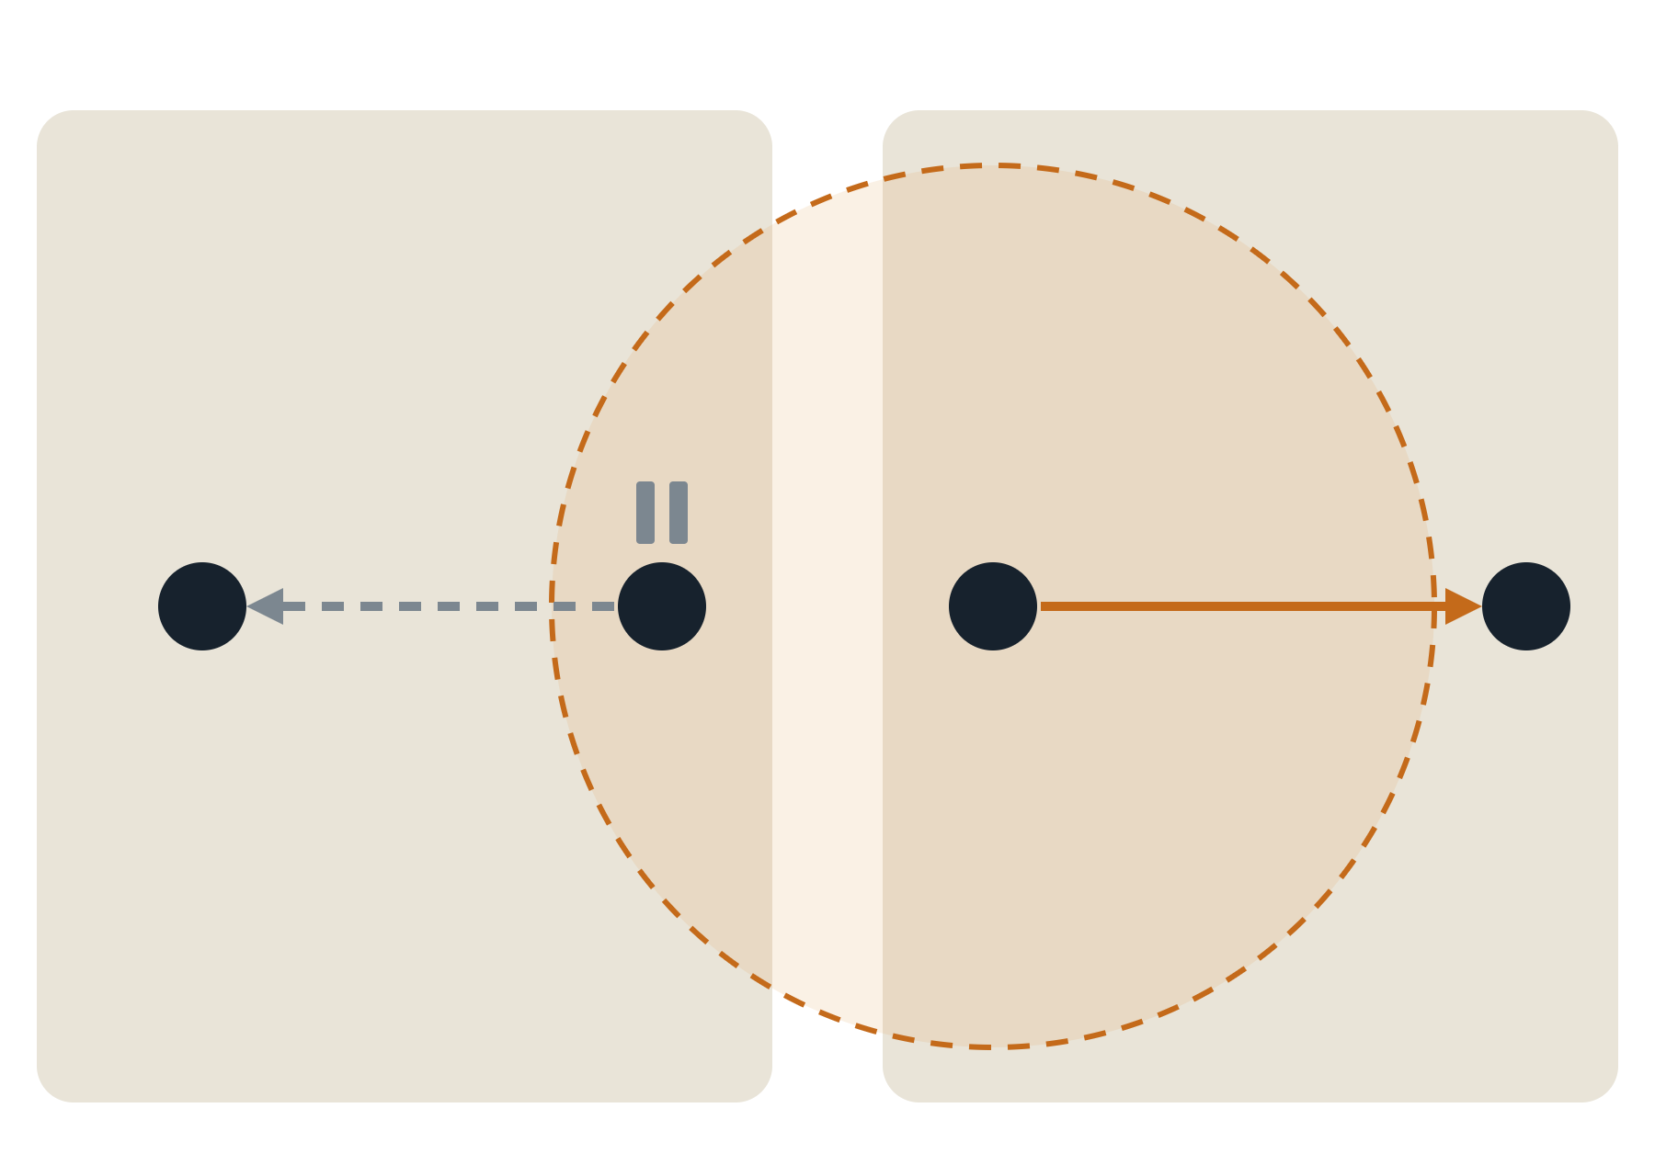
Between beds, neighbours mute each other
TWO BEDS, ONE CHANNEL · VIEW FROM ABOVE
PATHOLOGY II · MECHANISM
Sensor A hears Sensor B and backs off. Hub A is out of B's reach and Hub B out of A's, so both reports could have gone at once.
Bed A
Bed B
EVIDENCE · MEASURED
NIST simulations of co-located BANs: hidden and exposed nodes between networks raise delay and cut successful reception under 802.15.6 CSMA/CA [5].
Hub A
Sensor A
Sensor B
Hub B
EVIDENCE · MEASURED
A fixed energy-detection threshold can starve a node that sits badly among neighbouring BANs [6].
[5] Sayrafian, Barbi, Alasti (NIST), IEEE PIMRC 2016 · [6] Sayrafian, Barbi, Alasti, IEEE CSCN 2015
Notes:
Classic exposed-terminal geometry, mapped onto two adjacent beds. Evidence: Sayrafian, Barbi and Alasti at NIST studied multiple co-located BANs; their PIMRC 2016 abstract names inter-BAN interference from hidden and exposed nodes as a cause of higher delay and lower success under 802.15.6 CSMA/CA. Their CSCN 2015 paper shows static energy-detection thresholds can treat a node unfairly depending on where it sits among other BANs. Both are simulation studies built on measured channel data; say "simulated", not "field trial". Cost: vitals alarms have latency bounds, and every needless backoff eats into them.

Slide 9
Treatment: schedule, then coordinate
Fix | What it cures | What it costs
802.15.6 beacon mode with scheduled slots | Hub assigns slots, so back and chest never contend: no intra-body hidden pairs | Sync overhead; empty slots waste air
Two-hop relay or better hub placement | Routes around the torso shadow | Extra hop, latency and energy
Separate channels per BAN | Removes inter-BAN contention entirely | Few channels in a crowded ward
RTS/CTS added to 802.15.6 CSMA/CA [5] | Fewer inter-BAN collisions in simulation | Handshake overhead; no help for exposed nodes
Adaptive energy-detection threshold [6] | Fairer access for badly placed nodes | Too permissive and collisions return
Pattern to remember: contention is the problem. Where you control every node (one body), remove contention; where you don't (many bodies), negotiate it.
[5] Sayrafian et al., PIMRC 2016 · [6] Sayrafian et al., CSCN 2015 · rows 1–3: IEEE 802.15.6 MAC features
Notes:
Walk the table top to bottom: the first three are architectural (avoid contention), the last two are research patches to contention itself. Ask students why RTS/CTS helps the hidden-node half of the inter-BAN problem but cannot help the exposed half; the answer is that a CTS silences even more neighbours.

Slide 10
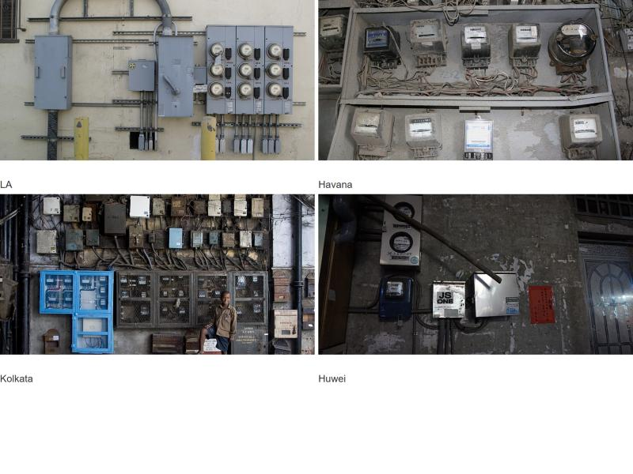
The dense apartment block
CASE 2 · SMART-METER MESH
Thousands of meters form a multi-hop mesh and report interval readings to a data concentrator, often all at the same interval boundary.
Layer | This deployment
Standard | IEEE 802.15.4 / 15.4g (ZigBee, Wi-SUN)
Topology | Tree or mesh toward one concentrator
Traffic | Synchronized interval reads, outage alarms
Photo slot · a meter room in an apartment block; Wikimedia Commons has openly licensed ones (check each licence)
Notes:
Set the scene: convergecast. All traffic flows toward one concentrator, so the relay meters near it are the bottleneck, and many utilities read on aligned interval boundaries, which synchronizes channel access. Concrete walls, basements and meter cabinets cut links between meters that are physically close.

Slide 11
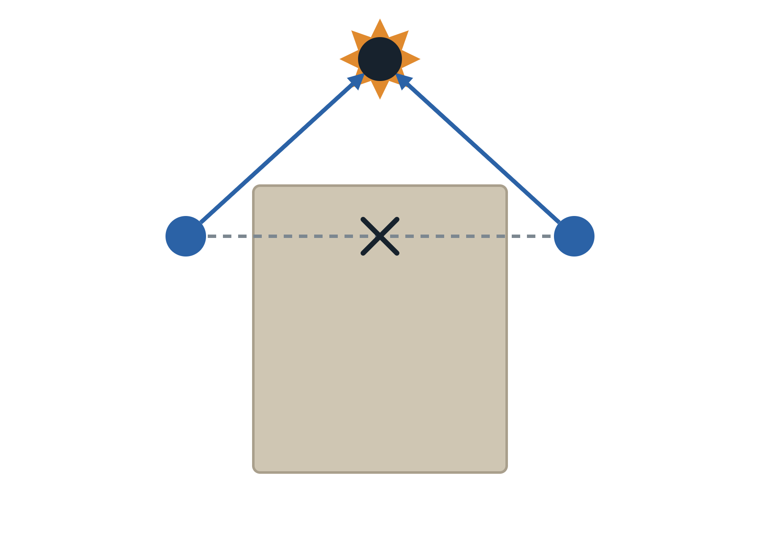
Concrete hides meters from each other
PATHOLOGY I · MEASURED
Relay on street pole
In dense 802.15.4 metering, thousands of meters use CSMA/CA toward one collector. Collisions come from synchronized access and from hidden nodes across collision domains [7].
COST · MEASURED
Meter battery life depends on the share of hidden meters and on the backoff limit [7].
Meter A
No link through
Meter B
INDUSTRY VIEW
A smart-metering patent calls hidden nodes ubiquitous in hierarchical metering networks [8].
CONCRETE BLOCK
Both report at the same interval boundary, and neither can sense the other.
[7] Elshabrawy et al., IEEE Sensors J. 17(7), 2017 · [8] US 2011/0185075 A1 (PRIME metering)
Notes:
Mechanism: two meters on opposite walls of the same building both have a clear path to a pole-mounted relay but not to each other. Add synchronized interval reporting and you get a collision every interval. Evidence: Elshabrawy et al. 2017 model report success probability and battery lifetime in dense 802.15.4 metering networks, explicitly separating collisions from synchronized access within a collision domain and from hidden nodes across domains. They quantify the hidden-node problem as the average percentage of hidden transceivers per meter. Patent US 2011/0185075 (PRIME, powerline-based hierarchy) states hidden nodes are ubiquitous in hierarchical metering networks. Note PRIME is powerline, so it shows the problem is not unique to radio.

Slide 12
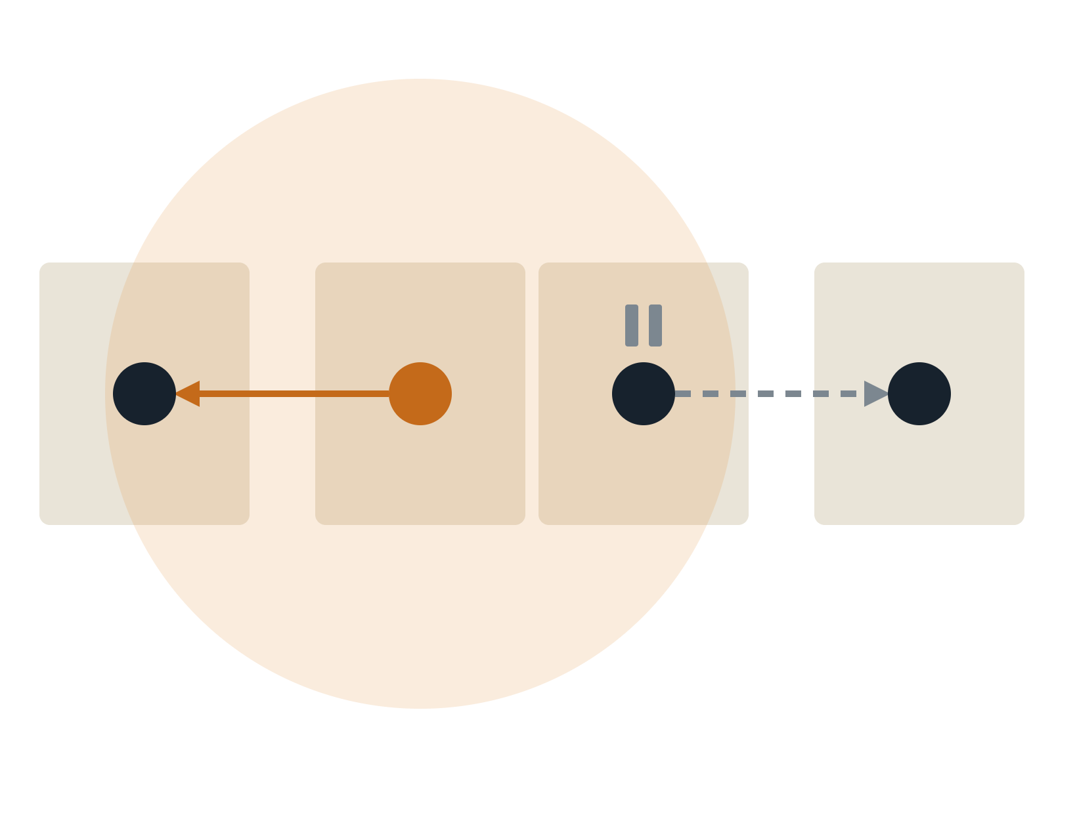
Next door, meters waste shared air
A ROW OF BUILDINGS · SHADED = METER C'S SENSE RANGE
PATHOLOGY II · MECHANISM
Meter D hears C sending west and defers its own hop east. Relay 1 can't hear D and Relay 2 can't hear C, so both hops could share the air.
WHY IT HURTS
Convergecast already funnels traffic into a few relays. Losing spatial reuse there stretches every reporting round.
EVIDENCE · MEASURED
On 802.15.4 radios, concurrent pairs succeeded 40–75% of the time inside each other's sense range [2]. Testbed motes, not meters.
Relay 1
Meter C
Meter D
Relay 2
C → Relay 1 and D → Relay 2 could run at once. Carrier sense says no.
[2] Son, Krishnamachari, Heidemann, USC/ISI TR-639, 2007 (MicaZ / CC2420)
Notes:
Same geometry as the primer, mapped onto a street. The exposed-terminal loss matters most near the concentrator, where every round must squeeze through a handful of relays. Evidence caveat: Son et al. measured concurrency opportunity on MicaZ motes, not on utility meters, so present it as what 802.15.4-class radios can do rather than a meter-network measurement. A good student question: why do utilities often accept this waste? Answer: meter traffic is low-rate and delay-tolerant, so they optimise reliability and battery first.

Slide 13
Treatment: desynchronize, then schedule
Fix | What it cures | What it costs
Random jitter on reporting time | Breaks the synchronized burst at interval boundaries | Reads arrive spread out; need timestamps
TSCH (802.15.4e) schedules | Dedicated cells per link plus channel hopping: contention mostly gone | Schedule upkeep, sync and join overhead
Level-alternating time frames [8] | Alternate tree levels, each other's hidden nodes, never overlap in time | Each level gets less airtime
Hidden-neighbour discovery [9] | Nodes learn their hidden pairs from neighbour tables, then adjust power or timing | Extra control traffic
Backoff tuning per hidden share [7] | Trades report success probability against battery life on purpose | Per-deployment engineering
Pattern to remember: traffic shape is half the disease. Synchronized convergecast turns occasional hidden pairs into a collision every interval.
[7] Elshabrawy et al., 2017 · [8] US 2011/0185075 A1 · [9] US 2012/0320768 A1
Notes:
Rows 1–2 are general practice (jitter is the cheapest fix of all; TSCH is what Wi-SUN-era stacks lean on). Row 3 is the patent's idea: nodes at alternate levels of the hierarchy are each other's hidden nodes, so give them different time frames. Row 4: a patent for low-power and lossy networks in smart grid and smart city field area networks identifies hidden neighbour relationships from received neighbour information. Row 5: Elshabrawy et al. show battery life can be optimised by controlling the hidden-node share together with the maximum number of backoffs.

Slide 14
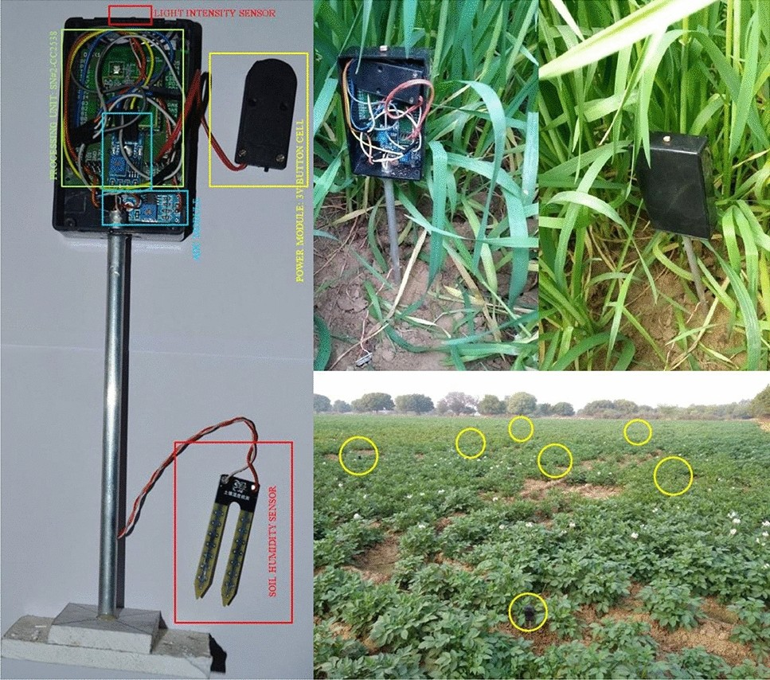
Wheat field, flying sink
CASE 3 · FARM + DRONE
Sensors sit low in the crop. A UAV collects their data, partly to escape the hidden-terminal collisions of multi-hop routing [14].
Layer | This deployment
Radio | 802.15.4 at 2.4 GHz on the ground
Topology | Clusters polled by a mobile sink
Traffic | Bursty: all upload while the drone is overhead
Photo slot · Pal et al., Sci. Rep. 11, 2021, Fig. 1: node prototype and wheat/potato field deployment (open access)
[14] Jawhar & Mohamed, UAV-based data communication in wireless sensor networks
Notes:
Set the scene. The appeal of a drone sink is that it replaces long multi-hop chains, which Jawhar and Mohamed explicitly motivate by the hidden-terminal and collision problems of multi-hop routing. The twist: the drone creates a new geometry with its own hidden and exposed terminals. Figure 1 of Pal et al. 2021 (Scientific Reports, open access) shows their actual CC2538 node and field deployment, a good photo for the frame.

Slide 15
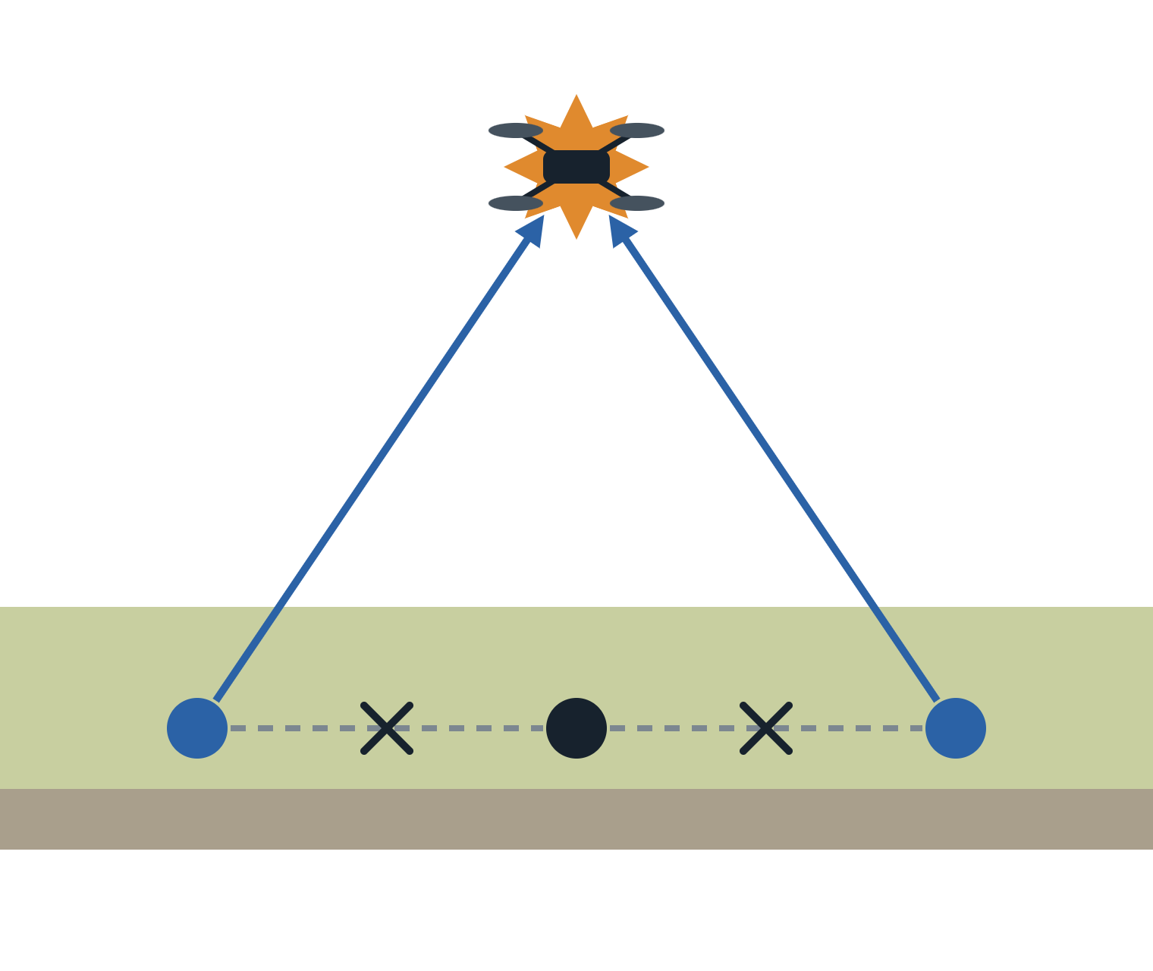
The crop grows a wall between sensors
SIDE VIEW
1.85 → 5.93
48 m → 8 m
Drone (mobile sink)
Path-loss exponent: assumed at sowing vs measured in mature wheat [10]
Link range at −75 dBm: free space vs mature wheat [10]
PATHOLOGY I · MEASURED + MECHANISM
Links dropped and the network partitioned as the wheat grew [10]. Sensors that heard each other at sowing are hidden from each other at harvest, yet all still see the drone.
Canopy
UAV SIDE · MEASURED
UAV data-collection work rejects 802.11-style CSMA/CA partly for hidden terminals; massed access collisions drain sensors and drones [13].
Node 1
Node 2
Node 3
[10] Pal et al., Sci. Rep. 11, 2021 · [13] Pan et al., Sensors 18(11):3951, 2018
Notes:
Evidence: Pal et al. deployed CC2538 nodes (antenna at 32 cm) in wheat and potato fields in Gwalior, India, over a full season. Their initial deployment assumed a path-loss exponent of 1.85; at wheat maturity they measured 5.93. Range at -75 dBm fell from about 48 m in free space to about 8 m in mature wheat, and they report link drops and network disconnectivity in later growth stages, while potato RSSI stayed consistent. The hidden-terminal reading is the MECHANISM part: shrinking ground-to-ground range while the ground-to-air path stays clear is exactly the hidden-terminal geometry. Pan et al. 2018 note that CSMA/CA (802.11-style) is considered unsuitable for UAV data collection due to overhead, energy and hidden terminals, and model MAC access collisions under a UAV.

Slide 16
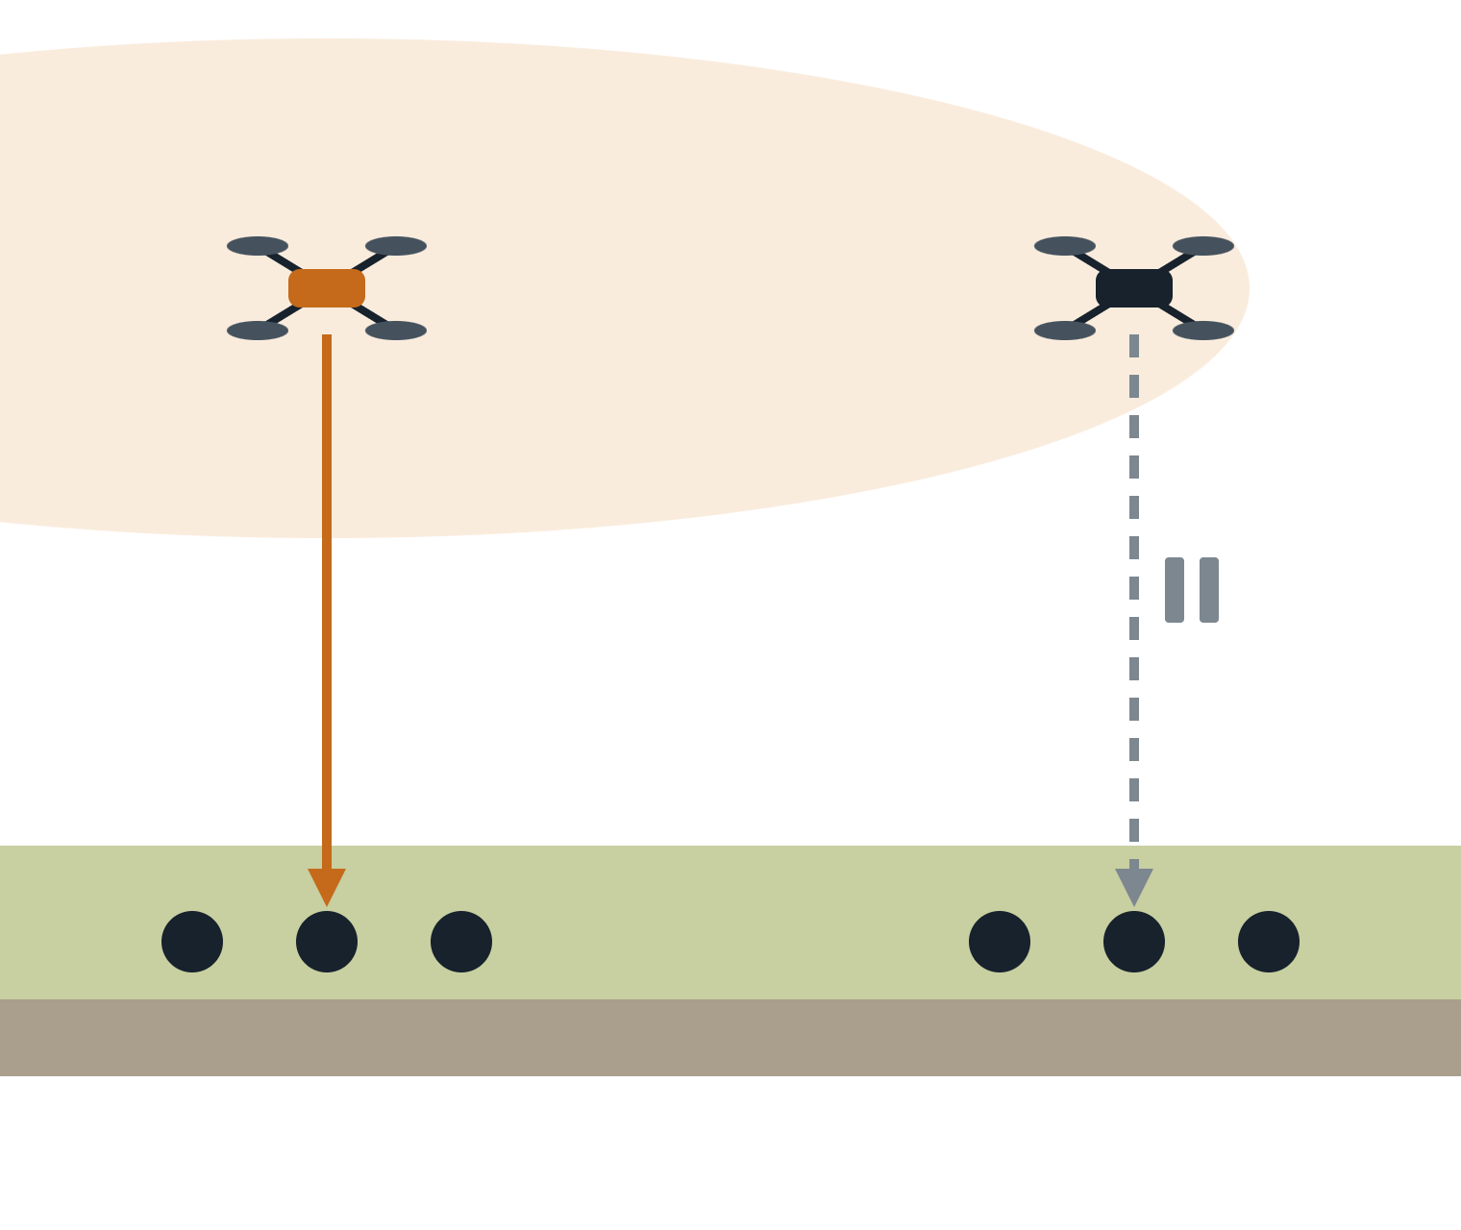
In the air, every drone hears every drone
SIDE VIEW · SHADED = DRONE A'S REACH
PATHOLOGY II · MECHANISM
Drone B hears Drone A polling and holds its own poll. Cluster B, down in the crop, barely hears A, so the pause buys nothing.
Drone A
Drone B
ELEVATION · MEASURED
Air-to-air: clear line of sight
Radios just 20 cm above a cotton or rice canopy reached beyond 1 km [11]. In wheat, the path-loss exponent falls as antennas rise [12]. Altitude inflates every sensing domain.
ASYMMETRY · MEASURED
Inside the crop, signal strength fell about 8 dB in cotton and 20 dB in rice over one season [11].
Cluster A
Cluster B
[11] Agricultural WSN WiFi range study, UNE, 2017 · [12] Wheat antenna-height study, Trans. CSAE
Notes:
Exposed-terminal geometry created by altitude: drone-to-drone links are clean line of sight, ground links are buried in the crop. So the sensing domain of each drone is huge in the air and small on the ground. Tag this one as MECHANISM: I did not find a paper that measures exposed-terminal deferral between data-collection drones; the measured part is the elevation effect. Evidence: the University of New England 2017 study measured WiFi range over a growing season, with signal falling about 8 dB in cotton and 20 dB in rice, and ranges beyond 1 km when radios stay 20 cm above the canopy. The wheat-field study in Transactions of the CSAE found path-loss exponent decreasing with antenna height and an optimal height around 1.2 m, a bit above mature wheat. Good project idea: simulate two drone sinks with and without carrier sense between them.

Slide 17
Treatment: let the drone conduct
Fix | What it cures | What it costs
Drone-initiated polling or TDMA slots | Ground nodes never contend, so hidden pairs stop mattering | Poll overhead; drone must know node IDs
Adapt flight speed to node density [13] | Fewer nodes compete per pass, fewer access collisions | Longer flights, more drone energy
Antennas above the mature crop [11][12] | Restores ground-to-ground sensing and shrinks hidden pairs | Taller masts, cost, machinery clearance
Deploy for harvest, not sowing [10] | Spacing set with the end-of-season exponent keeps the network connected | More nodes per hectare
Swarm: one channel or schedule per drone | Removes air-to-air exposed deferrals | Spectrum and coordination
Pattern to remember: the topology is seasonal. A link budget measured at sowing is a promise the crop will break.
[10] Pal et al., 2021 · [11] UNE, 2017 · [12] Trans. CSAE · [13] Pan et al., 2018 · rows 1 and 5: general MAC practice
Notes:
Pan et al. 2018 adapt UAV speed to the density of devices under coverage so access collisions stay low and more devices finish uploading within the flight. Pal et al. 2021 use measured, growth-stage-dependent path loss to plan node deployment. The antenna-height studies say put the radio above the mature canopy; the wheat study found about 1.2 m optimal. Rows 1 and 5 are standard practice rather than findings from these papers.

Slide 18
Same two pathologies, three organs
Case | Hidden: what blocks | Exposed: what overhears | What drifts | Fix that works
Body area network | The torso, between chest and back nodes | The neighbouring patient's BAN | Posture and movement, by the minute | Scheduled slots inside; channels between
Smart-meter mesh | Walls and floors, plus synchronized reads | Adjacent meters routing to different relays | Mostly static; load spikes each interval | Report jitter plus TSCH schedules
Farm + drone | The crop canopy between ground nodes | Other drones, in clear air | Crop height, over the season | Drone polling; antennas above the crop
In every case the cause is asymmetry: the sender's view of the channel differs from the receiver's. Geometry, bodies, buildings and crops just decide how.
Notes:
Recap slide. Ask students to fill the table themselves before revealing it. The unifying idea: carrier sense estimates the receiver's channel from the sender's position, and every deployment breaks that estimate in its own way. Note the time column: BANs change by the minute, crops by the season, meters barely at all, which is why meters can be planned statically and BANs cannot.

Slide 19
Your turn: three questions
LAB · BAN
DESIGN · METERS
DEBATE · DRONES
Put one mote on a volunteer's chest, one on the back, a hub at the hip. Predict the collision rate as they turn around, then measure it.
A utility reads 10,000 meters at :00, :15, :30 and :45. Propose the cheapest change that cuts hidden-node collisions. What does it cost billing?
Two drones serve two fields from 30 m up. Should they carrier-sense each other at all? Argue both sides with the exposed-terminal picture.
Notes:
Q1 is cheap to run with any two 802.15.4 boards and gives students the hidden-terminal effect with their own bodies. Q2 answer sketch: random jitter within the interval; cost is less precise timestamps unless readings are stamped at the meter. Q3: carrier sense between drones protects the rare case where clusters overlap, but in the common case it is pure exposed-terminal loss; a schedule or channel split per drone usually wins.

Slide 20
Sources
[1] Barroca et al., 802.15.4 with RTS/CTS and frame concatenation, IET Wireless Sensor Systems, 2020
[8] US 2011/0185075 A1, System and method for preventing collisions in a hierarchical network
[2] Son, Krishnamachari, Heidemann, Importance of concurrent packet communication, USC/ISI TR-639, 2007
[9] US 2012/0320768 A1, Reducing the impact of hidden nodes in mesh networks
[3] IEEE 802.15 TG6, Channel Model for Body Area Network, P802.15-08-0780, 2009
[10] Pal et al., GA-optimized node deployment in IEEE 802.15.4 potato and wheat crop monitoring, Sci. Rep. 11, 2021
[4] Alam et al., Realistic simulation for body area and body-to-body networks, Sensors 16(4):561, 2016
[11] Characterization of WiFi signal range for agricultural WSNs, Univ. of New England, 2017
[5] Sayrafian, Barbi, Alasti, RTS/CTS for 802.15.6 CSMA/CA, IEEE PIMRC 2016
[12] Impact of antenna height on 2.4 GHz channel propagation in wheat fields, Trans. CSAE
[6] Sayrafian, Barbi, Alasti, Energy detection threshold in 802.15.6 CSMA/CA, IEEE CSCN 2015
[13] Pan et al., Dynamic speed control of UAVs for data collection under IoT, Sensors 18(11):3951, 2018
[7] Elshabrawy et al., Dense 802.15.4 metering networks with hidden nodes, IEEE Sensors J. 17(7), 2017
[14] Jawhar, Mohamed, UAV-based data communication in wireless sensor networks: models and strategies
Notes:
Titles are shortened to fit; each link opens the full record. All links are to public pages: open-access papers, standards documents, NIST abstract pages or patent records. For [3], search the IEEE 802.15 document server for 15-08-0780. Several NIST and IEEE items are abstracts only; the full papers sit behind IEEE Xplore.

